Slide 1

Lambda
HackTricks Training
https://t.me/CyberFreeCourses

Slide 2
Basic Information - Lambda
Amazon Web Services (AWS) Lambda is a compute service that lets you run code without provisioning or managing servers. Lambda automatically manages the resources required to run your code and provides high availability, scaling, and security features. With Lambda, you only pay for the compute time that you consume, and there are no upfront costs or long-term commitments.
To run a lambda it's possible to call it manually, with a frequency (with Cloudwatch), expose an URL endpoint and call it, call it via an exposed API Gateway endpoint or even based on events such as changes to data in a S3 bucket or updates to a DynamoDB table.
Metadata: Lambda machines don’t have access to the metadata endpoint, so they store the credentials of the IAM role in environment variables (/proc/self/env).
https://t.me/CyberFreeCourses
https://cloud.hacktricks.xyz/pentesting-cloud/aws-pentesting/aws-services/aws-lambda-enum

Slide 3
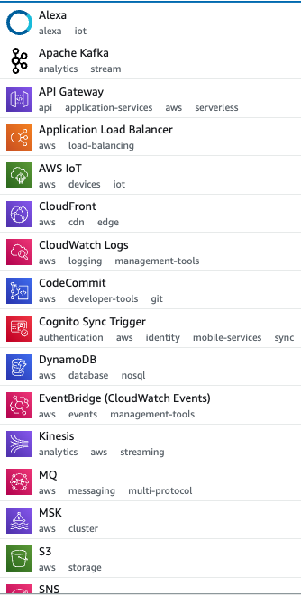
Basic Information - Lambda Triggers
Manual
aws lambda invoke --function-name FUNCTION_NAME /tmp/out
## Some functions will expect parameters, they will access them with something like:
## target_policys = event['policy_names']
## user_name = event['user_name']
aws lambda invoke --function-name <name> --cli-binary-format raw-in-base64-out --payload '{"policy_names": ["AdministratorAccess], "user_name": "sdf"}' out.txt
Via exposed URL
aws lambda list-function-url-configs --function-name <function_name> #Get lambda URL
aws lambda get-function-url-config --function-name <function_name> #Get lambda URL
Exposed via API Gateway
aws lambda get-policy --function-name <function_name> #API Gateway ID
aws --profile level6 --region us-west-2 apigateway get-stages --rest-api-id "s33ppypa75" #Get API stages
Final URL: URL:https://<rest-api-id>.execute-api.<region>.amazonaws.com/<stageName>/<funcName>
https://t.me/CyberFreeCourses
https://cloud.hacktricks.xyz/pentesting-cloud/aws-pentesting/aws-services/aws-lambda-enum

Slide 4
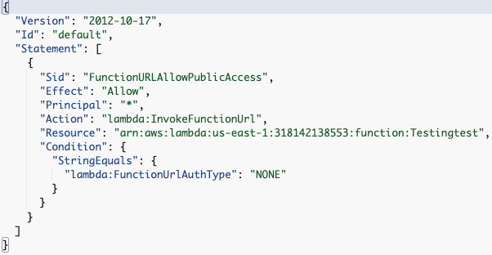
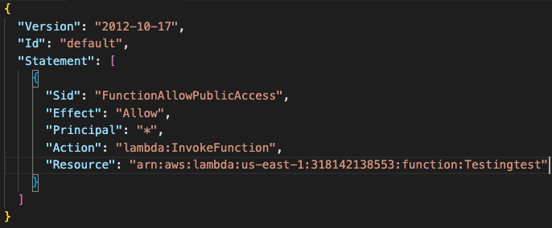
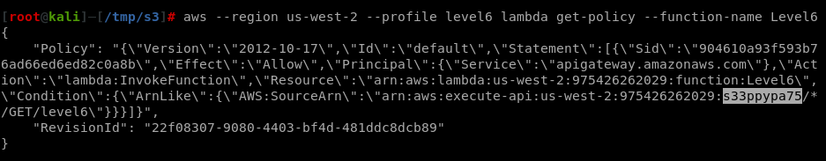
Basic Information - Lambda Resource Policies
URL exposing Lambda:
Allow everyone to invoke the Lambda:
https://t.me/CyberFreeCourses
API Gateway exposing Lambda:
https://cloud.hacktricks.xyz/pentesting-cloud/aws-pentesting/aws-services/aws-lambda-enum

Slide 5
Manual Enumeration
# List functions and get details
aws lambda list-functions
aws lambda get-function --function-name <function_name>
# Get env variables (sensitive information)
aws lambda list-functions | jq '.Functions[].Environment'
# Download lambda code
aws lambda get-function --function-name "LAMBDA-NAME-HERE-FROM-PREVIOUS-QUERY" --query 'Code.Location' --profile uploadcreds
wget -O lambda-function.zip url-from-previous-query
# Get Lambda URL (if any)
aws lambda list-function-url-configs --function-name <function_name>
# Get who has permissions to invoke the Lambda
aws lambda get-policy --function-name <function_name>
# Versions and Aliases
aws lambda list-versions-by-function --function-name <func_name>
aws lambda list-aliases --function-name <func_name>
https://t.me/CyberFreeCourses
https://cloud.hacktricks.xyz/pentesting-cloud/aws-pentesting/aws-services/aws-lambda-enum

Slide 6
Post Exploitation
Stealing Others Requests
If a Lambda is exposed in an URL (public URL or API Gateway) and an attacker gets RCE. He could steal other user’s requests and steal potential sensitive information from those requests.
Substitute the bootstrap script with malicious code to be able to intercept data sent to the Lambda function.
Lambda Extensions
This is also a persistence technique
Load a layer that will run an external extension (extensions/)
External extension will overwrite the memory of init changing the API port to a port controlled by the attacker
Init will run bootstrap with the modified env var
Attacker will MitM communications to lambda but also other extensions communications (steal sensitive info, change requests, break security extensions)
https://t.me/CyberFreeCourses
For more information check https://cloud.hacktricks.xyz/pentesting-cloud/aws-pentesting/aws-post-exploitation/aws-lambda-post-exploitation
Notes:
Create IAM role for lambda without permissions
Create RCE lambda
Get shell, check metadata, and steal others requests

Slide 7
Persistence
Lambda Layers
Create external layer backdooring a library the victims code use and give access to victims account
Set layer in the victim's Lambda
Remove access to use layer (lambda will still be able to access it, but victim won’t be able to directly download the layer)
Version Backdoor + API Gateway
Create a backdoored version and then create a newest version with the original code
Create a new API endpoint that uses the backdoored version
Versions, Aliases & Weights
Create a backdoored version and then create a newest version with the original code
Create aliases with weights that execute the legit one 99% of the time and 1% the backdoored one
Event actuator
If something happens (new user created), do something (create API creds and send to attacker)
For more information check https://cloud.hacktricks.xyz/pentesting-cloud/aws-pentesting/aws-persistence/aws-lambda-persistence
https://t.me/CyberFreeCourses

